Slide 1
Hertz Vectors
George Filippatos, Daniel Scarbrough

Slide 2

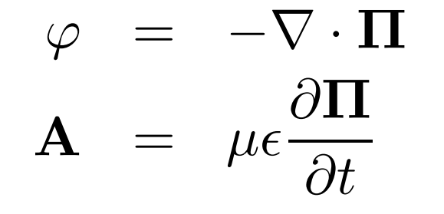
What are Hertz Vectors?
An alternative formulation of the Electromagnetic potentials
Applicable when electric or magnetic polarization is present
Presented mostly as a practice problems in EM textbooks
Practical applications with waveguides, antennae, and any polarized material.

Slide 3
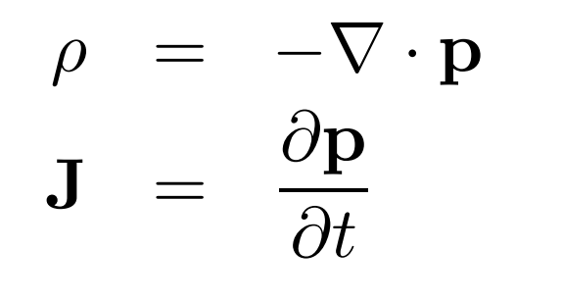
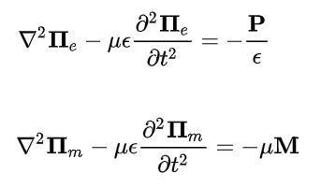
Wave Equation
The Hertz vectors treat any polarization as a source.
  Much easier than accounting for a distribution of charge in many cases
Are determined via the wave equation for each, dependent on appropriate polarization

Slide 4
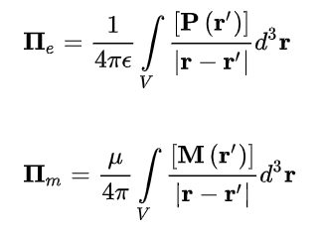
Resulting Vectors
Solving the wave equation yields these results
Follows the familiar 1/r form
Integrates over the volume of the source of polarization
  Similar to how we might integrate over a distribution of charge
Interesting in that P and M can be generated similarly
  e.g. current flow in various forms

Slide 5
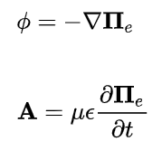
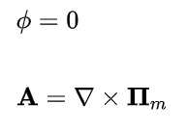
Scalar and Vector Potential
Defining the potentials for one type of source
Electric polarization
Magnetic polarization

Slide 6
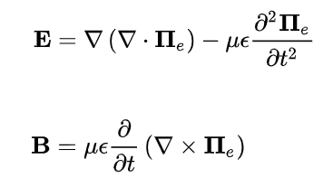
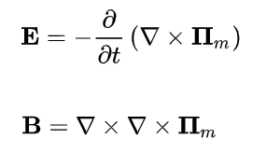
Obtaining the Fields
Considering only one type of polarization source at a time, the fields are easily determined from the scalar and vector potentials

Slide 7
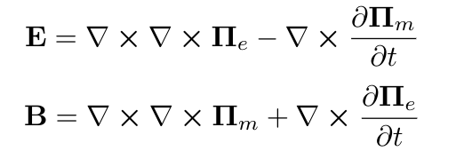
Obtaining the Fields
Considering two types of polarization present, the fields become

Slide 8

Example - Oscillating Dipole
Consider an infinitely thin wire of a short length l at the origin aligned in the z-axis
Carries a uniform current that oscillates with time
  Not only adjusts amplitude, but also flips direction of polarity
Finding charge distribution with time adds complexity
  Just define the polarization and use the electric Hertz vector instead
Can be evaluated at the retarded time t’=t-|r-r’|/v

Slide 9
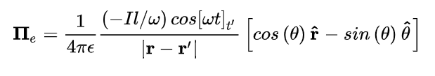
Writing the Hertz vector
Inserting the polarization into the electric Hertz vector integral equation
  Due to limited and small dimensions of the source, it simplifies over the volume integral
  It follows the 1/r form, so transformation to spherical coordinates is convenient
  Polarization is only present in the z-axis, so only r and theta components exist

Slide 10

Finding the Fields
Directly taking derivatives with respect to r quickly becomes messy due to the 1/r potential which accounts for source coordinate r-prime
Using Legendre polynomials eases the differentiation
  Only the first few terms of the series need to be used
    The source is assumed to be small (r’ << r)
    r’/r^{l+1} quickly converges to zero in series

Slide 11
Hertzian Dipole Electric Field
The cosine term is evaluated at the retarded time, which is spatially dependent
  The terms due to chain ruling spatial derivatives on the cosine drop out due to the speed of light in the retarded time
    Looking relatively close to the dipole to observe the field

Slide 12
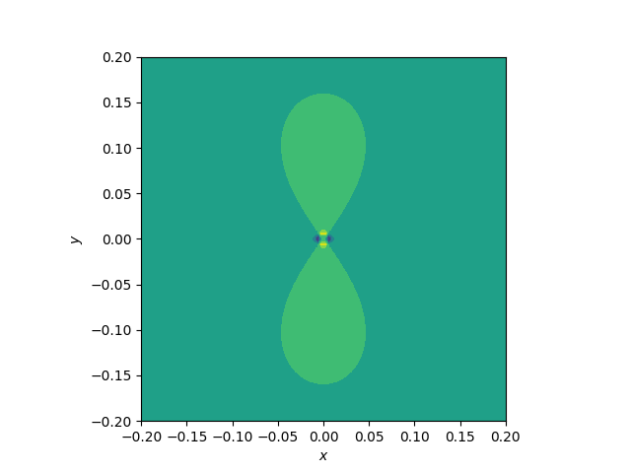
Simulating Result in Python

Slide 13


Magnetic Polarization Example
Another example involving a current
Consider a small diameter loop of infinitely thin wire carrying a uniform current
  Current again varies with time, with a negative value again representing a change in flow direction
  Loop lies in the x-y plane
    Right Hand Rule - see polarization in the z-direction
  Magnetic moment is

Slide 14
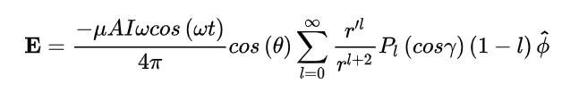
Magnetic Loop Electric Field
Converting the z-hat coordinate vector to spherical to perform the cross products in terms of spatial coordinate r leads to the following result

Slide 15
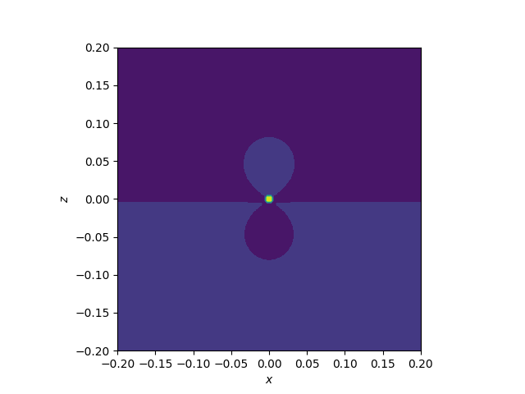
Simulating Result in Python

Slide 16
References
[1] E.A. Essex, "Hertz vector potentials of electromagnetic theory", American Journal of Physics 45, 1099 (1977); doi: 10.1119/1.10955
[2] J. Galejs, Antennas in Inhomogeneous Media, (Pregamon, Oxford,1969).
[3] H. R. L. Lamont, Wave Guides, (Metheun, London, 1963).
[4] Elbistan, M. 2018, Physics Letters A, 382, 189
[5] Application of Electrodynamics http://space.fmi.fi/~viljanea/eds2005/

